Slide 1
Strange Times in the DPRK:
-The release of three American captives
causes speculation

Slide 2
What’s the story?
November 8, 2014, Democratic Peoples Republic of Korea released 2 captured Americans: Kenneth Bae & Matthew Todd Miller
James Clapper, the Director of National Intelligence escorted them home.
Only three weeks after releasing Jeffrey Fowle
The release occurred just as President Obama was beginning a week long tour of Asia.

Slide 3
Continued…
Also coincided with the delivery of a personal note from Mr. Obama to North Korea’s leader, Kim Jon Un.
James Clapper had traveled to NK to negotiate the release of Miller and Bae.
He was sent because he had a background in Korean issues and is a national security official.
He is the highest-level American government emissary to visit NK in over 10 years.

Slide 4
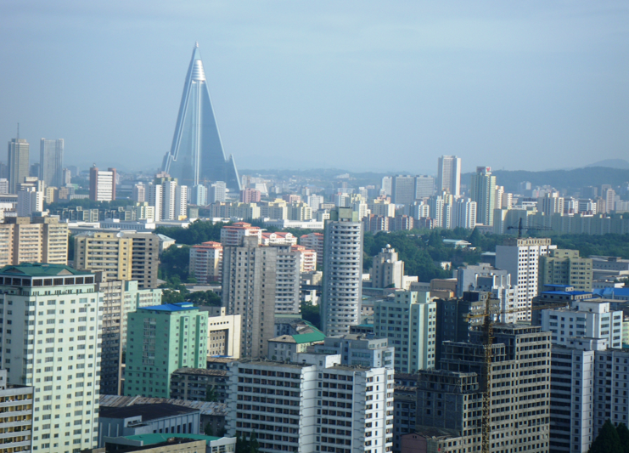
Background:
Pyongyang is the capital of the DPRK/ the largest city.
It has been feeling pressure from the international community.
Poor relationship with China
currently.

Slide 5
Continued…
Last December, the execution of Jang Song Thaek, led to a significant change in the nature of the China-North Korea alliance.
Kim Jong Un assumed power on the death of his father.
Had given uncle Jang nearly free rein to handle relations with Beijing.
Brutal removal of Uncle Jang from the center of power

Slide 6
Continued…
Meant the two capitals lost much of their ability to communicate with the other.
Eradication of Jang’s nationwide patronage network in subsequent “reign of terror” eliminated underlings who had handled China matters for Jang.

Slide 7
Recently,
Three top NK officials traveled to South Korea to meet with officials & attend Asian games.
Also had a top diplomat travel to New York to meet with the UN and fight report describing NK’s prison camp system and human-rights abuses.

Slide 8
Why the fuss?
Some believe this move might give the Obama administration the opportunity to confront the threats of NK’s nuclear program and human rights abuses.
In the past, Pyongyang has always demanded something of value in return for wayward Americans. However, a State Department official said U.S. gave nothing in return for Bae and Miller.

Slide 9
Continued…
Many believe there must be more “behind the scenes” ; Releasing hostages as goodwill gestures is not how the Kim family operates.
Another explanation: could be that NK policy makers may be trying to make the Chinese nervous

Slide 10
Conclusion.
These were the last two Americans held in North Korea.
In conclusion, all eyes will be on North Korea to see if their motives will be revealed.

Slide 11
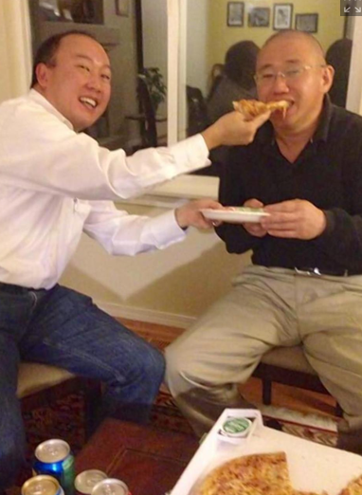
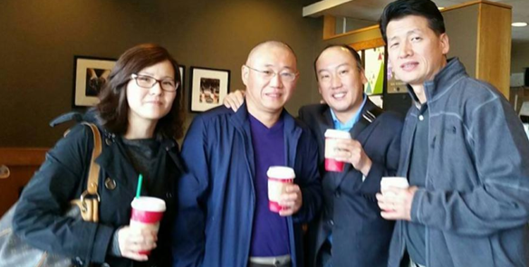
Update:
Kenneth Bae and his family eating Starbucks and pizza following his arrival in the States.

Slide 12
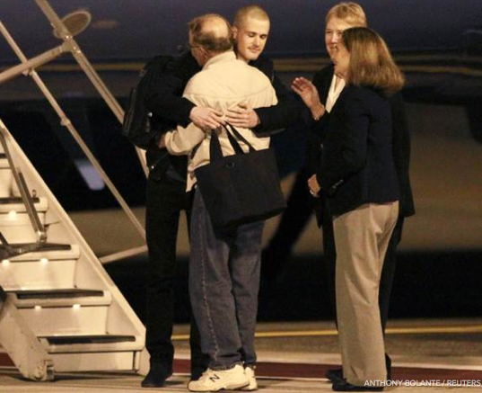
Matthew Todd Miller being greeted by his family upon arriving on U.S. soil.

Slide 13
Sources:
http://online.wsj.com/articles/north-koreas-release-of-american-prisoners-fuels-speculation-about-pyongyangs-plans-1415582386
http://www.thedailybeast.com/articles/2014/11/08/why-north-korea-released-two-americans.html
http://edition.cnn.com/2014/11/09/world/asia/us-north-korea-detainees-released/index.html?hpt=ias_c2
http://www.npr.org/2014/11/10/362952847/pyongyang-releases-2-u-s-citizens-who-were-held-for-months
http://www.nydailynews.com/news/national/n-korea-kenneth-bae-eats-pizza-day-home-article-1.2006515
http://www.nbcnews.com/news/us-news/north-korea-captives-kenneth-bae-matthew-todd-miller-land-u-n244211

