Slide 1
India and Al-Qaeda
By: Seth Sheldon

Slide 2
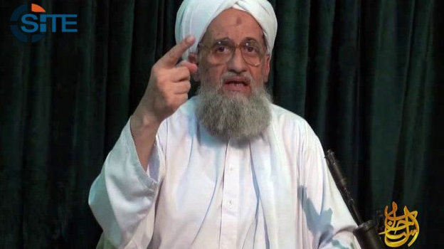
Al-Qaeda leader Ayman al-Zawahiri
After year of silence, last week he released video announcing to join newly established Al-Qaeda faction in India
He specifically named three states in India: Assam, Gujarat, and Kashmir (in which there’s already an insurgency brewing)
Also mentioned Bangladesh and Burma

Slide 3
Possible Reasoning
Though only a handful of people in India have joined jihadist groups, 13% of India’s 1.2 billion people are Muslim. (contrary to say, the U.S., which is only around .8% of 314 million)
Reassert relevance
Last reported attack was January of 2013 (in Algeria)
Overshadowed as of late by ISIS
Losing spotlight/relevance with the beheadings of journalists James Foley and Steven Sotloff
Isis rapidly mobilizing and gaining ground in Iraq and Syria

Slide 4
Reaction
Press Headlines
"Clear and Present Qaeda Danger,” (The Times of India).
"India Now In Al Qaeda sights,” (The Hindu).
Analysts
that this should be seen through the lens of a ”fading franchise” and a somewhat hopeless attempt at gaining members
some conclude it is a very viable threat due to the unstable nature of insurgents in the Islam dominated state of Kashmir

Slide 5
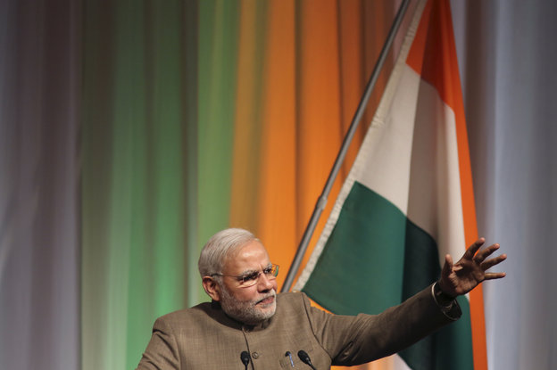
Reaction
Government
Indian Prime Minister (Narendra Modi)
In his first Interview with International Media since his election in may..
"My understanding is that they are doing injustice toward the Muslims of our country. If anyone thinks Indian Muslims will dance to their tune, they're delusional," he said. "Indian Muslims will live for India. They will die for India. They will not want anything bad for India.”
Modi said it was not about “one country” or “one race” but about “humanity vs. inhumanity”
Remarks come ahead of his meeting with President Obama later this month in Washington in which Islamist groups will likely be a big part of both of their security agendas.

Slide 6
Sources
http://www.npr.org/blogs/parallels/2014/09/05/346122891/will-al-qaida-find-followers-in-india
http://www.npr.org/blogs/thetwo-way/2014/09/19/349842637/indias-modi-calls-al-qaidas-plans-for-his-country-delusional

