Slide 1
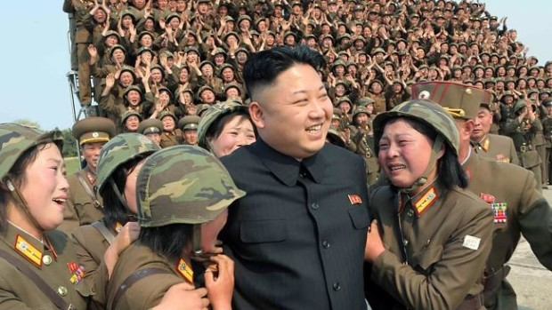
Kim Jong-Un Returns

Slide 2
A report on state television said on Thursday the 26th of September that Mr. Kim, 31 was in an “uncomfortable physical conditions”
The supreme leader was absent from a session of the Supreme People’s Assembly, his absence at the SPA- to which he was elected in March with 100% of the vote- renewed speculation about the leader’s whereabouts.

Slide 3
Kim made his last public appearance on September 3rd when he attended a musical.
Previous appearances, showed a clearly overweight Mr. Kim walking with a limp and wearing generously cut trousers, possibly to disguise his walking difficulties.
An anonymous source said to be “familiar with North Korea affairs”- quoted by Yonhap, said that Kim was suffering from gout, hyperuricemia, hyperlipidemia, obesity, diabetes and high blood pressure.
It was rumored that Kim Jung-Un secretly flew Western doctors to North Korea to perform surgeries, and routine checkups on the Supreme leader. But those reports have not been confirmed.
During his absence the Supreme leader missed two high profile meetings- the anniversary of the establishment of the Korean’s workers party and the Foundation Day of the North Korean State.

Slide 4
Back to Business
Kim got back to his routine on Tuesday. KCNA said that Mr. Kim was briefed on the Wisong Scientists Residential District.
While looking over the exterior of the apartment houses he expressed great satisfaction. Mr. Kim also visited the newly built natural Energy Institute of the State Academy of Sciences.
After all the speculation Mr. Kim is physically unfit but his power is undiminished

Slide 5
Sources
"North Korean Leader 'has Illness'" BBC News. N.p., n.d. Web. 14 Oct. 2014.
"Dancing" Kim Jong-un Video Goes Viral -." RSS. N.p., n.d. Web. 14 Oct. 2014.
"N Korea Leader 'appears in Public'" BBC News. N.p., n.d. Web. 13 Oct. 2014.

