Slide 1
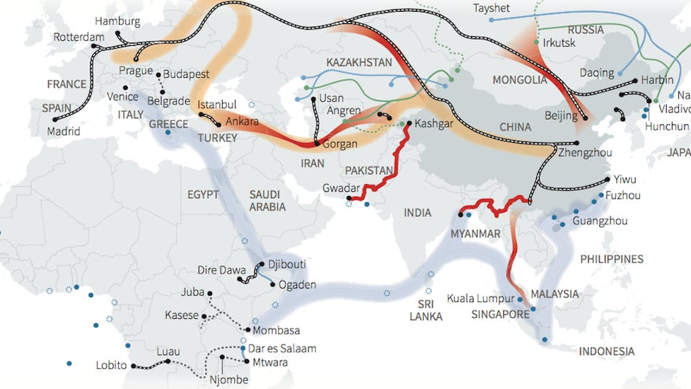
Economy and Power
Investing in Influence

Slide 2
One Belt One Road
China intends to invest between one trillion and eight trillion dollars in the developing areas of the world by 2049
It involves partnering with dozens of countries around the world through trade and infrastructure projects, such as shipping lanes, railroads, and airports.
This will have significant implications for the future of the world

Slide 3
Silk Goals
China intends to develop the infrastructure of the developing world
To many countries this provides an alternative to the World Bank and its requirement for investment
This is particularly popular in countries that have questionable human rights records such as Pakistan
Through these investments China hopes to display that its model of development can be applied and is a plausible solution

Slide 4
Southeast Asia
Southeast Asia is a major part of China’s plan
China has a plan to build a highspeed railway that extends from Laos to Thailand
This railroad will significantly lower travel times and provide more interconnectivity
This will allow China to become more integrated with the reason
China also has plans to build many new rubber solar and industrial manufacturing plants in Thailand
This among other projects will provide China with a presence in Southeast Asia

Slide 5
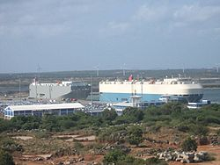
Debt Trap
Opponents of the massive infrastructure project say that it is simply a way to force countries to concede politically to China through economic means
While China plans to invest heavily in its peripheral regions this isn’t altruism. China wishes to maintain a heavy trade surplus with these countries as they develop. This will allow China to more easily maintain its economic growth.
This is demonstrated in practice Magampura Mahinda Rajapaksa Port, which is now leased to China

Slide 6
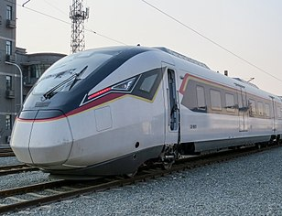
Pushback
Mahathir Mohamad A politic leader in Malaysia and Prime Minister has referred to the investments China has made as selling the country to foreigners.
MRL East Coast Rail Link is intended to connect eastern and western economic zones of Malaysia and will carry freight and passengers

Slide 7
Returns on Investment
China has yet to recoup much of the money that it has invested in the countries around it but the project is only 7 years old, so the future is uncertain
Regardless of economic implication it is certain that the One Belt One Road has brought China to a new position of power in the world
Furthering many of the projects that are attributed to the belt and road existed prior and were just rebranded by President Xi of China

Slide 8
Shortcomings
It is likely that President Xi views the Belt and Road Initiative as a pet project
Despite stringent capital controls on any Chinese investments outside the BRI only 12% of Chinese foreign investments goes to countries participating in the BRI
Roughly 1/3 of this investments goes to already developed nations such as Israel or South Korea. While at the same time many countries are mad at China for throwing its money around the prime minister of Malaysia even went so far as to call the project “New Colonialism”

Slide 9
References
https://foreignpolicy.com/2018/12/06/bri-china-belt-road-initiative-blunder/
https://www.businessinsider.com/what-is-belt-and-road-china-infrastructure-project-2018-1
https://www.cfr.org/backgrounder/chinas-massive-belt-and-road-initiative
https://blogs.worldbank.org/trade/three-opportunities-and-three-risks-belt-and-road-initiative

