Slide 1
Academic Technology
New Faculty Orientation 2021
Brian Hopkins, Penny Rice,
Amelia robbins, Chris Reichley,
Teresa mcCarver, Lindsey Sneed

Slide 2
Welcome to Academic Computing
Information Technology Helpdesk
  https://olemiss.edu/helpdesk/
  helpdesk@olemiss.edu; x5222
Faculty Technology Development Center
  https://olemiss.edu/ftdc/
  ftdc@olemiss.edu; x7918
Classroom Technology
  https://olemiss.edu/umct/
  umct@olemiss.edu; x2850
IT Media
  https://olemiss.edu/itmedia/
  itmedia@olemiss.edu; x7908
Mississippi Center for Supercomputing Research
  https://mcsr.olemiss.edu/
  assist@mcsr.olemiss.edu; x3036

Slide 3
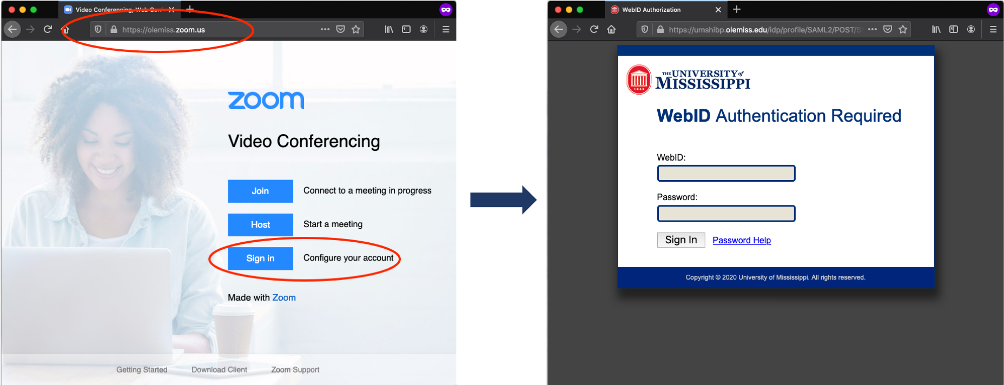
Zoom @ UM
All faculty, staff, students have latent Licensed accounts that can be auto-provisioned at first login.

Slide 4
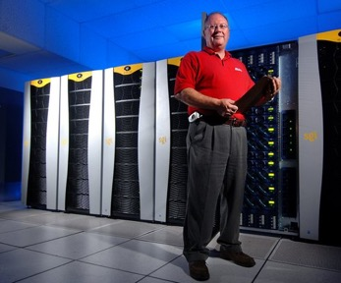
MCSR
The Mississippi Center for Supercomputing Research (MCSR) provides computing resources, training, and support for faculty, staff, and students at all of Mississippi’s public Institutions of Higher Learning (IHLs).
Contact Information
  Phone – 662-915-3036
  Email – assist@mcsr.olemiss.edu
  mcsr.olemiss.edu

Slide 5
IT Security
Breaches result in real cost to the organization
  Cost - ~$100-$148/compromised record
You’re more likely to experience a data breach of at least 10,000 records (27.9%) than you are to catch the flu (5–20%, according to WebMD)
Email: The No. 1 threat vector used for malware, phishing attacks and ransomware

Slide 6
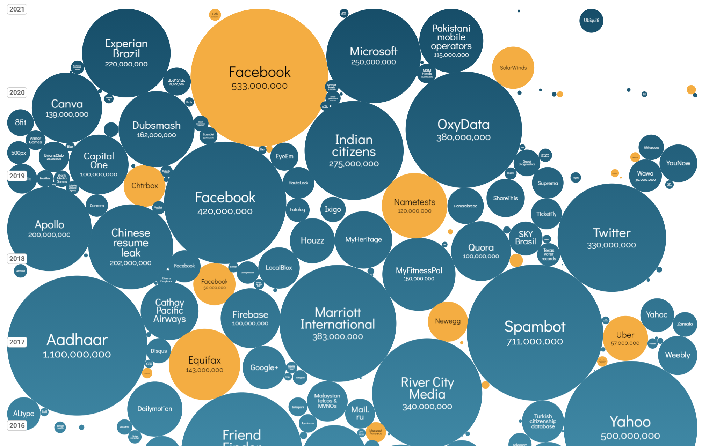
Impact of Security Breaches

Slide 7
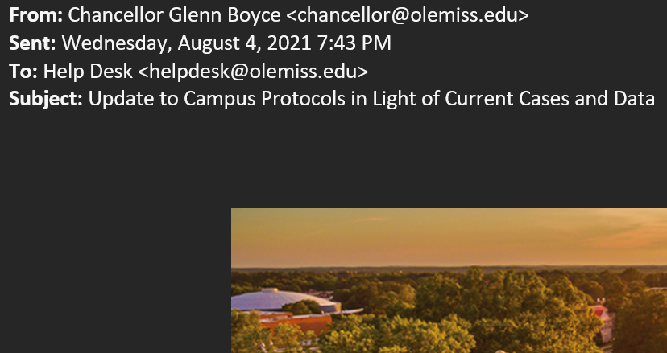
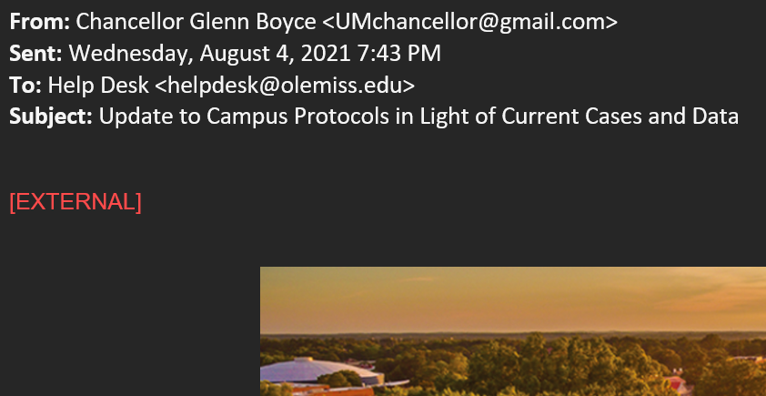
Email Security

Slide 8
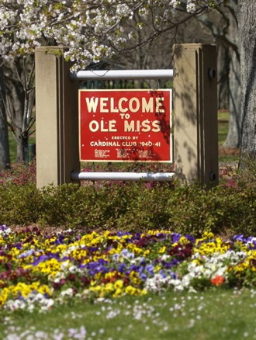
Questions
Brian Hopkins
  bwhopkin@olemiss.edu

Slide 9
Faculty Technology Development Center
Penny Rice
Amelia Robbins

Slide 10
FTDC
Faculty Technology Development Center
  Phone – 662-915-7918
  Email – ftdc@olemiss.edu
  Website – olemiss.edu/ftdc
  Hours – Monday – Friday, 8:00am – 5:00pm
  Virtual Office Hours via Zoom – Monday – Friday, 1:00-2:00pm
  https://olemiss.zoom.us/j/995909765
Notes:
The FTDC staff are happy to assist UM faculty, staff, and TAs with issues related to software and hardware. We provide support for Blackboard, Panopto, Test Scoring, Faculty Activity Reports, Course Materials Management, and other applications that run on the University's campus wide systems. The best way to reach us is by email. All Blackboard or Panopto related questions should be addressed to blackboard@olemiss.edu. Any other request for assistance can be directed to ftdc@olemiss.edu. Additionally, you can call 662-915-7918 and speak to an FTDC student worker weekdays between 8:00am and 5:00pm. FTDC Staff are also available for virtual office hours via Zoom weekdays from 1:00-2:00 pm or for one-on-one assistance by appointment.
The FTDC lab, located in Weir Hall, is open to walk-in traffic. If you need access to any of the special equipment or services, such as video digitization or document/slide scanning, please come by.

Slide 11

Blackboard
The FTDC is responsible for the administration of the campus Blackboard server.
Workshops are offered throughout the year and one-on-one training is provided as needed.
If you need assistance with any aspect of Blackboard, consult the Blackboard Help Pages (olemiss.edu/blackboard) or contact blackboard@olemiss.edu.

Slide 12
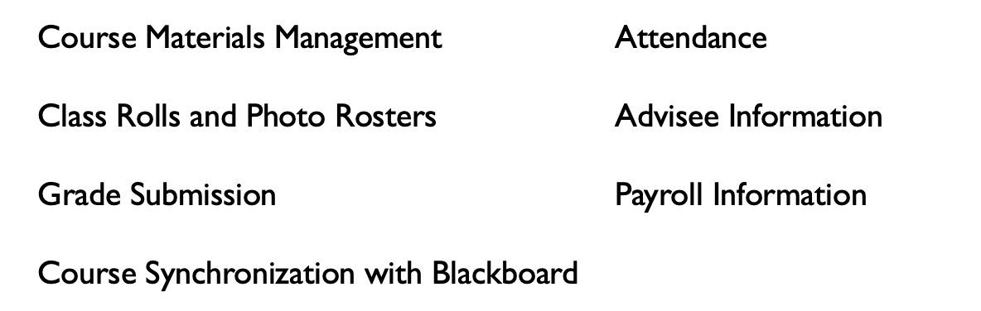
myOleMiss
The University’s myOleMiss portal has many applications and features used by faculty throughout the year. These include:
my.olemiss.edu
Contact ftdc@olemiss.edu with questions

Slide 13
Training
FTDC offers faculty and staff workshops emphasizing the development of classroom media presentations and other instructional technologies.
IT Training - Other sessions are offered periodically in addition to those mentioned above.
Special sessions for departments or one-on-one training may be arranged by contacting FTDC.
Register at ittraining.olemiss.edu.

Slide 14
Attendance
The University must abide by federal guidelines to verify the attendance of students in each class for which they are enrolled. The University is providing two ways for instructors to submit this information: classroom attendance scanners or the attendance verification (AV) interface.
attendance.olemiss.edu
olemiss.edu/gotoclass

Slide 15
TACIT
Funded by the Provost Office and facilitated by IT, this program is designed to replace a faculty member’s outdated computer; giving more immediate access to–and ready capacity to create–technology resources.
olemiss.edu/tacit/

Slide 16



Software for Departmental Purchase
Licenses for Microsoft software and Adobe software are available through FTDC.
These licenses may be purchased for installation on any university-owned computer.
Software purchase request form
  olemiss.edu/software
Symantec Endpoint AntiVirus
  Free for employees’ work and home computers
  itsecurity.olemiss.edu/antivirus
E-mail software@olemiss.edu with any questions.

Slide 17
UMCT
Classroom Technology (UMCT) is administered by the Office of Information Technology with funding from the Provost's Office to enhance the campus infrastructure with equipment such as multimedia lecterns, LCD projectors, and projection screens.
Website – olemiss.edu/umct
Email – umct@olemiss.edu

Slide 18

What is Blackboard?
An online course management system available to UM instructors for posting course materials, assignments, blogs, wikis, discussion boards, online tests, grades, etc.
blackboard.olemiss.edu

Slide 19
How do I get my course onto Blackboard?
Enable it for use in Blackboard
Through myOleMiss Class Rolls and Grades interface
Enrollments synchronized multiple times each day

Slide 20

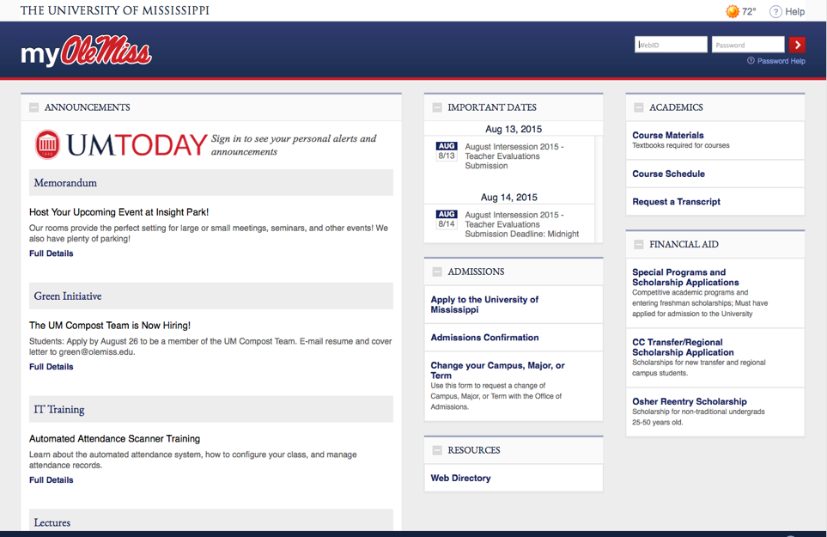
Logging in to MyOleMiss

Slide 21
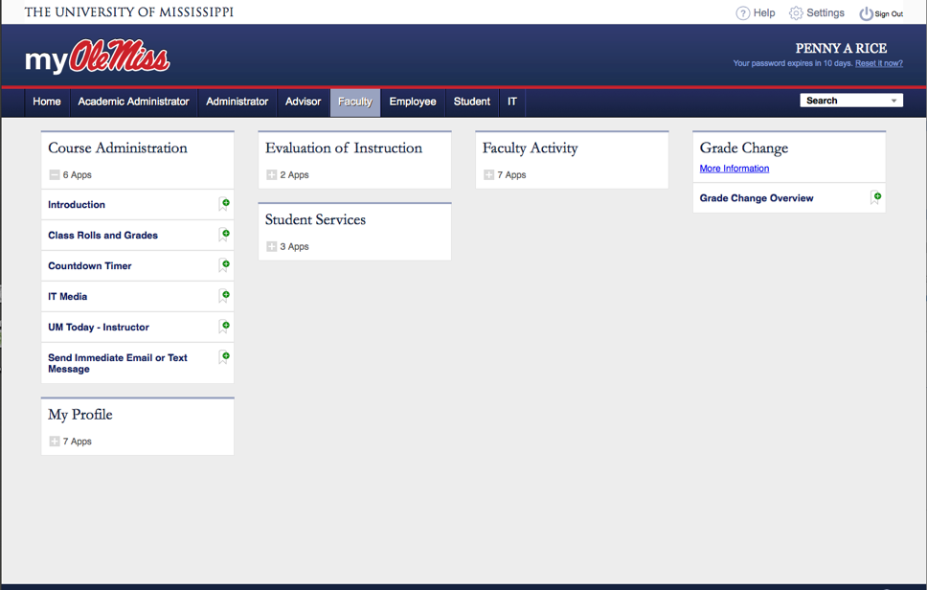
Under the faculty Tab

Slide 22
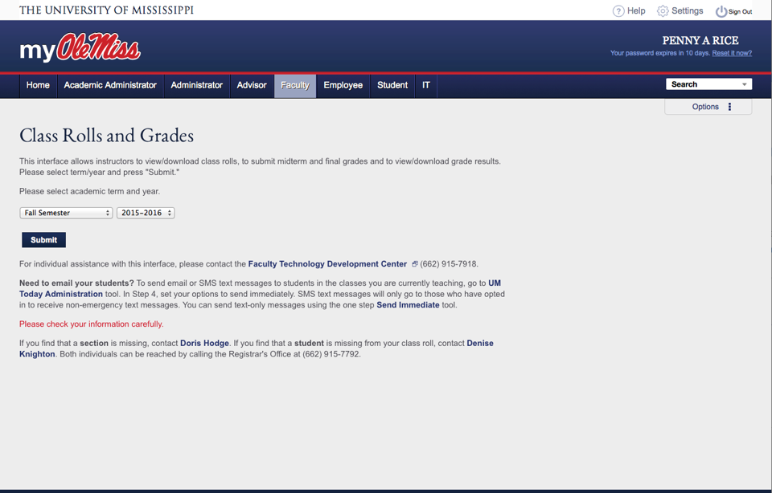
Class Rolls and Grades
2021-2022

Slide 23
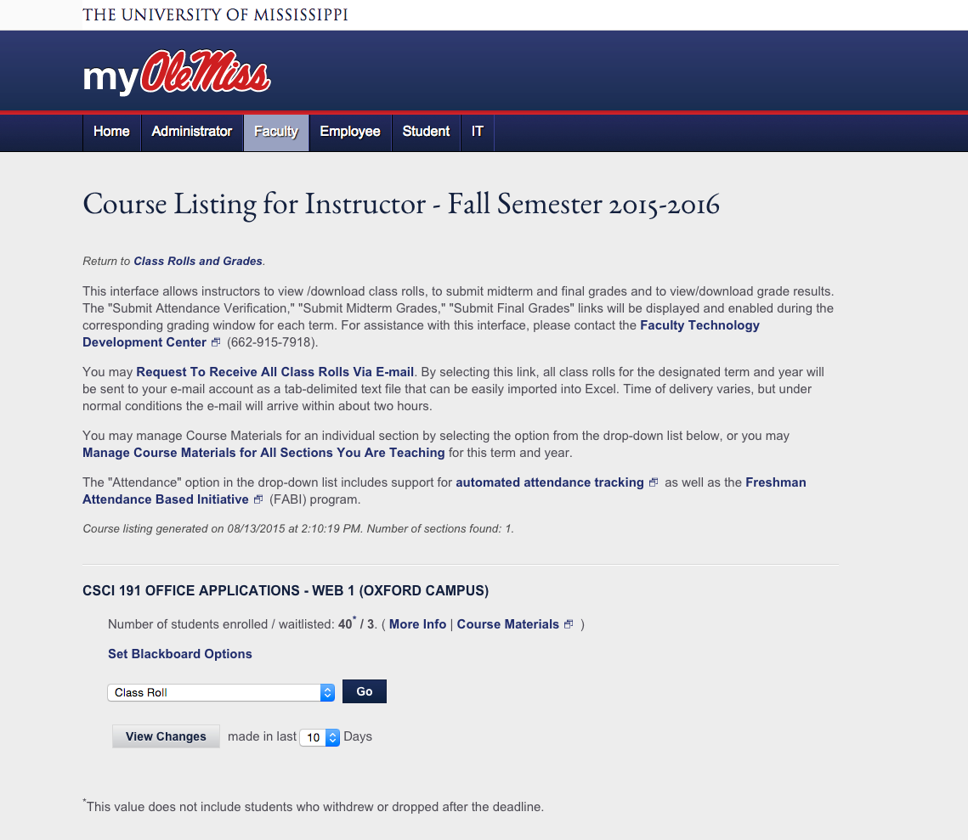

Course Listing for Instructors
2021-2022

Slide 24
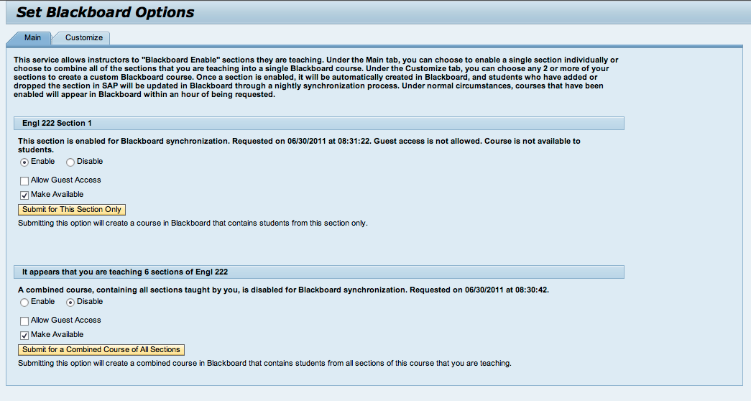
Setting Blackboard Options

Slide 25
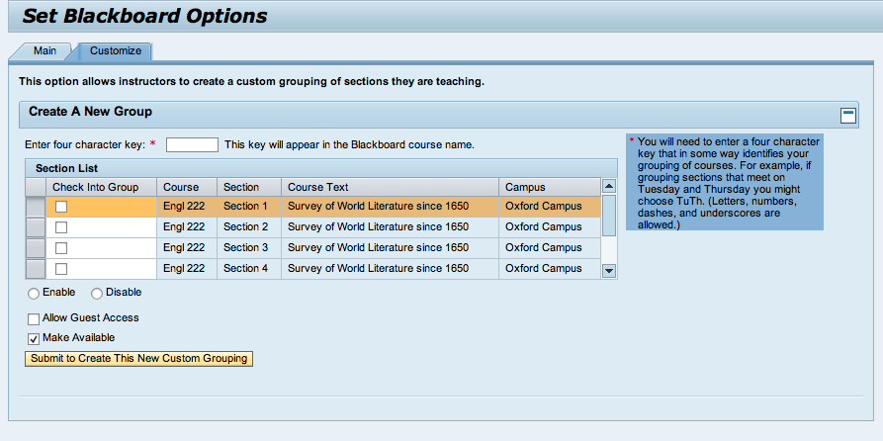
Customizing Blackboard Options

Slide 26
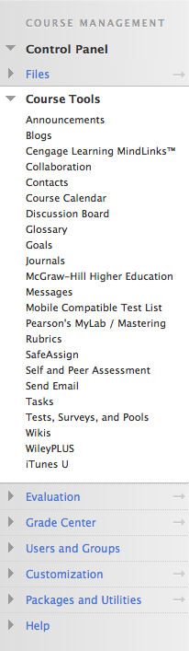
Notable Features
Assignments
Plagiarism Detection
Bb Annotate
Discussion Boards
Blogs, Journals & Wikis
Attendance
Self & Peer Assessments
Online Tests
Respondus
Grade Center
Rubrics
Portfolios
Retention Center

Slide 27
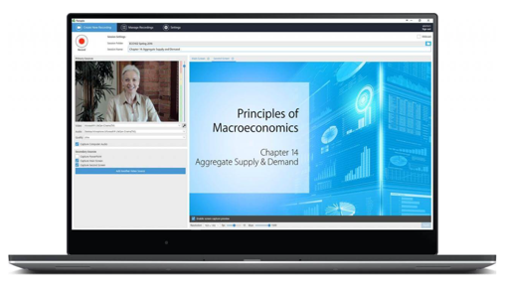
Panopto
Record and Share videos in Blackboard
Narrate PowerPoints
Embed quizzes
Auto-captioning

Slide 28
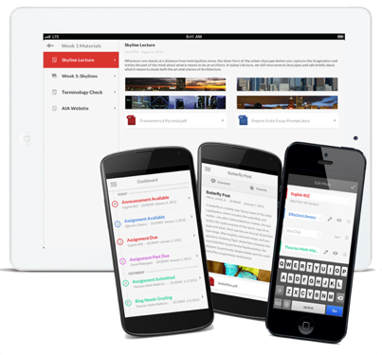
Blackboard Mobile
For Students
App available for Apple iOS and Android
View course content, participate in discussion boards, take quizzes, view grades, etc.
Receive push notifications of new course activity

Slide 29

Blackboard Instructor
App available for Apple iOS and Android
Preview content and assessments
Create and reply to discussions
Send announcements
Grade, markup, and add video comments to assignments

Slide 30

Blackboard Assistance
Tutorials
  Help link within Blackboard
  Bb Help – Instructors link in course
  olemiss.edu/blackboard
Workshops and one-on-one
training available through
the FTDC
Contact Information
  Phone – 662-915-7918
  Email – blackboard@olemiss.edu

Slide 31
Qualtrics
Available to faculty, staff, and students
Distribute unlimited surveys and collect unlimited responses
Free training and support provided through Qualtrics
uofmississippi.qualtrics.com

Slide 32
Questions for Penny and Amelia
Penny Rice
  parice@olemiss.edu
Amelia Robbins
  amelia@olemiss.edu

Slide 33
Accessibility Solutions
Lindsey Sneed

Slide 34
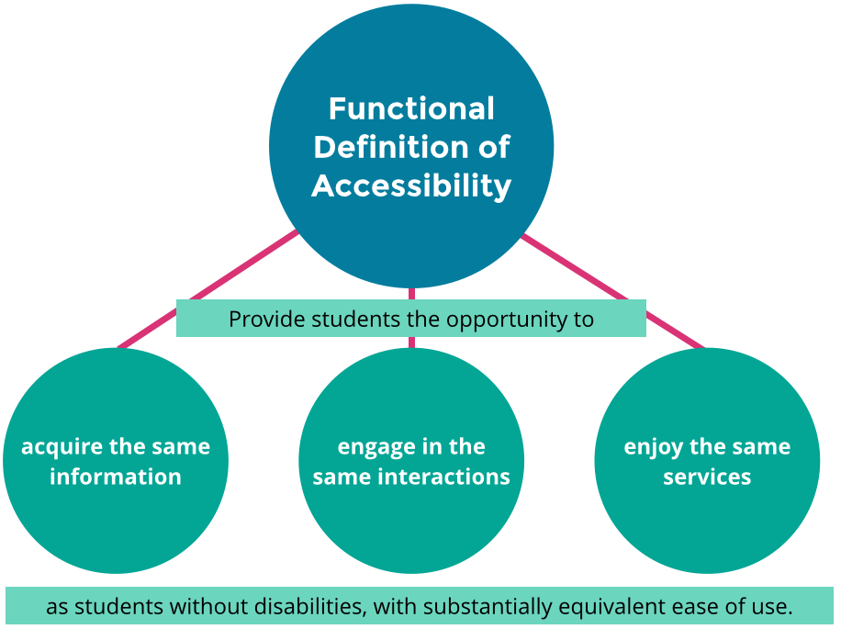
What is Accessibility?
Fully
Equally
Independently

Slide 35

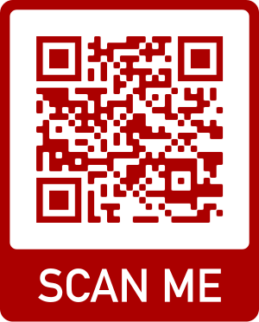
Upcoming Virtual
New Faculty
Digital Accessibility Training
Complete the Online Form:
accessibility.olemiss.edu/register
OR
Choose either:
Monday, August 30th at 2pm
OR
Tuesday, August 31st at 10am

Slide 36
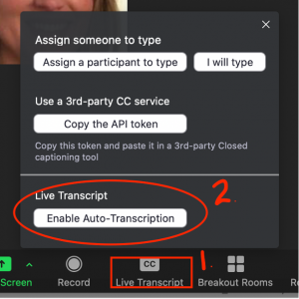
Zoom Live Captions/Transcripts
Enable them each time you have a synchronous Zoom class meeting.
The host must enable the live Captions so students can access them using the “CC” button on their Zoom toolbar.

Slide 37

Captions for Recorded Video
Videos You Create
Use Panopto. The auto-generated captions** are a great baseline to easily improve accessibility and comprehension and very easy to edit.
Videos You Find and Share
On YouTube, easily search for videos that already have captions.
** Unedited auto-generated captions DO NOT meet the standard of accuracy for a student with an accommodation.

Slide 38
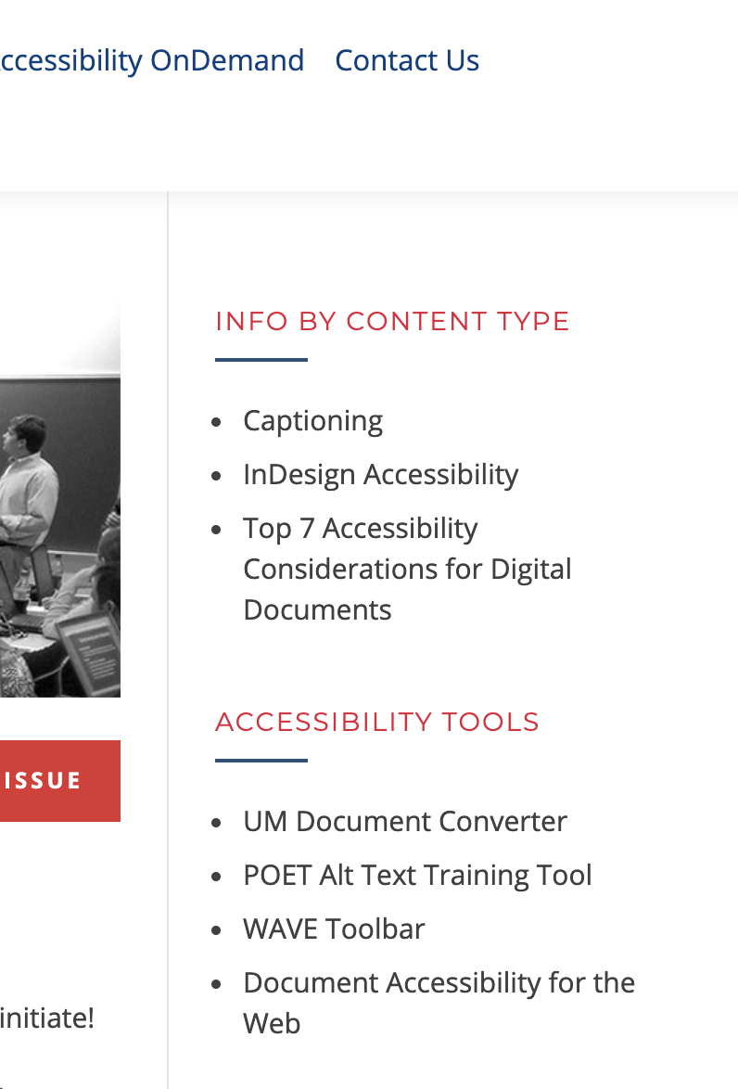
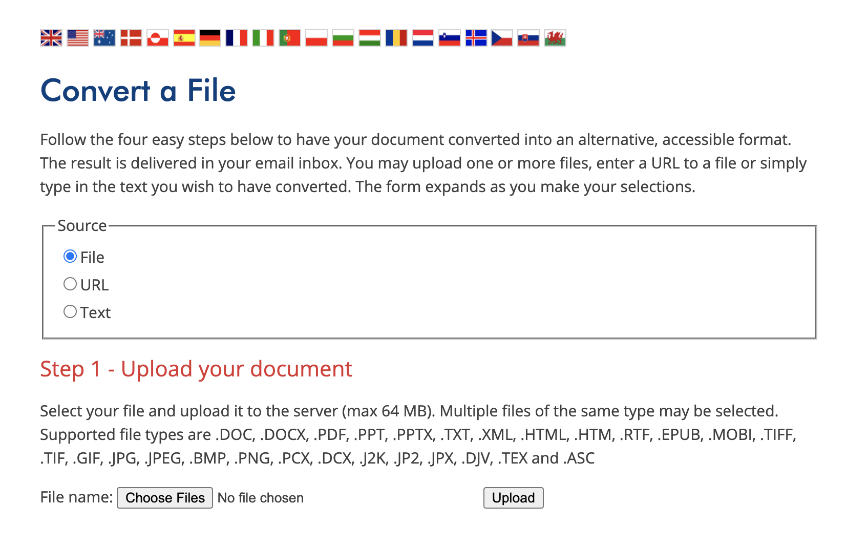
UM Document Converter

Slide 39
Questions for Lindsey
Lindsey Sneed
  lrs@olemiss.edu

Slide 40
IT Helpdesk
Teresa McCarver

Slide 41
Helpdesk
Email
Password
Software installation
Data transfer
Network troubleshooting
Virus removal
Much more

Slide 42

UM Box
Enterprise version of Box.com at box.olemiss.edu
  Encrypted, secure, FERPA/HIPAA compliant
1 TB of cloud storage – need more let us know
Alternative to USB drive
Collaboration
Box apps available
  Box Edit
  Box Sync
  Box Drive
box.olemiss.edu

Slide 43
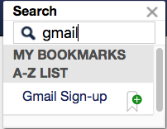
UM Gmail
UM Gmail accounts are available to employees so that they can use Google Apps for Education.
Sign up in myOleMiss
go.olemiss.edu
Notes:
As a part of the Google Apps for Education offering, faculty and staff may request a UM Gmail account. Instead of a replacement, this will be an additional account for UM Gmail and other Google apps, leaving the UM Mail (Exchange) account to be used for official UM correspondence. UM Gmail accounts are being made available to employees so that they can use Google Apps for Education in their roles as instructors and students. Visit go.olemiss.edu to learn how to sign up for UM Gmail for Employees.

Slide 44
Questions for Teresa
Hours
  Monday – Friday
  7:30 AM – 5:00 PM
Contact Information
  Phone – 662-915-5222
  Email – helpdesk@olemiss.edu
  olemiss.edu/helpdesk

Slide 45
Faculty Self-Service
Chris Reichley

Slide 46
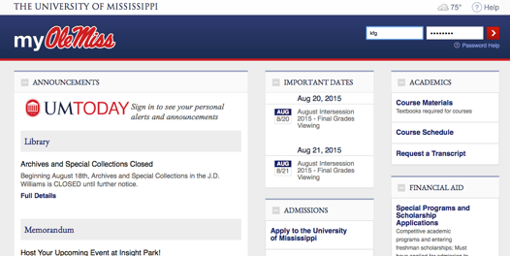
WebID
Why?
What does it give me access to?
  myOleMiss
    my.olemiss.edu
  Email
  Blackboard
  Wireless
  Box
  Library Services
  Other
Protect your WebID
  Be sure to sign out!

Slide 47
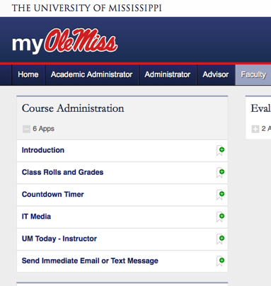
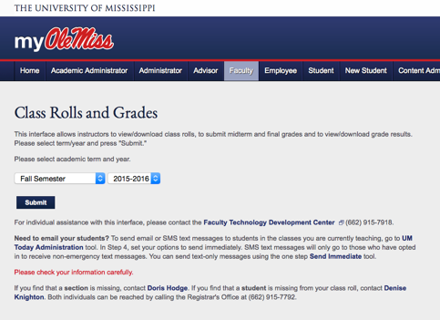
Class Rolls and Grade

Slide 48
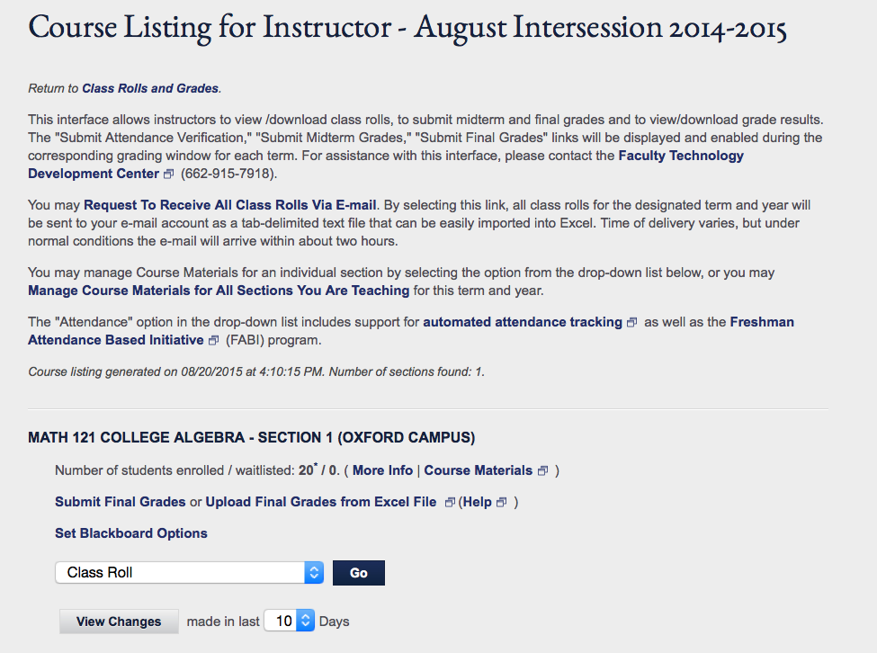
Course Listing for Instructor Uses
Submit/Upload Midterm Grades, Submit/Upload Final Grades, Submit Attendance Verification links will appear when the time is right.

Slide 49
Attendance Verification
New process to identify and act on students who register for classes but never attend or participate
Important Websites
  olemiss.edu/gotoclass
  common.olemiss.edu/docs/attendance.html
AV reports must be submitted for all classes.

Slide 50
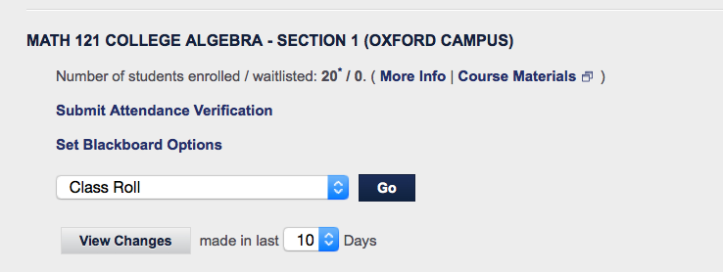
Submitting Attendance Verification
Link will appear in “Class Rolls and Grades” when the submission window is open. This link is also available from “Attendance” in the drop-down through out the term. If the window has closed, the submit buttons will be disabled.

Slide 51
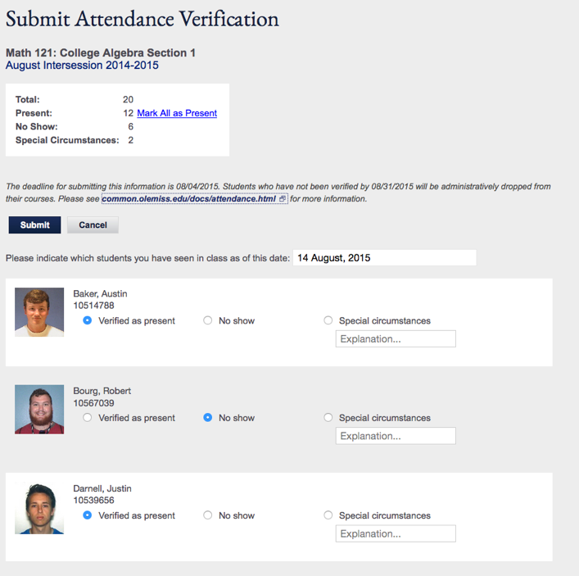
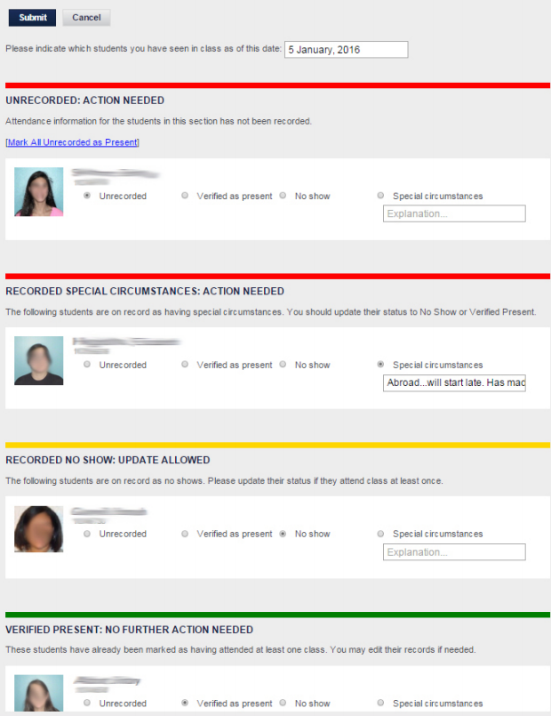
Populated attendance Verification
Note that we need to know “as of this date,” not “on this date.” Also, the on-screen instructions are slightly different for alternate format classes. In these cases, we need to know whether the student has “actively participated in a meaningful way.”
If instructor is in a scanner-enabled classroom, interface will indicate this.

Slide 52
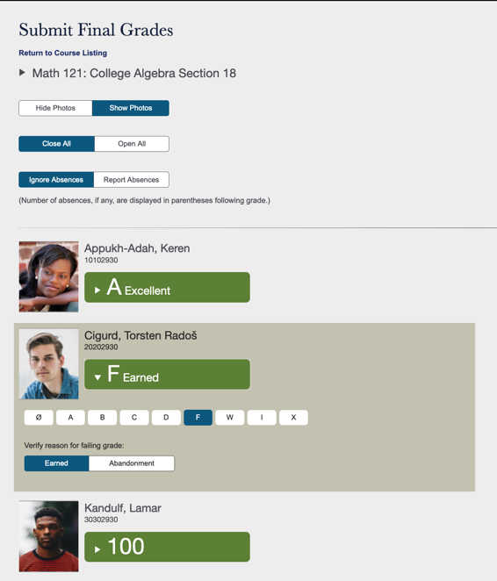
Submitting Final Grades
Screen shot generated from test system. Data is not real.

Slide 53
More on Grading
Online submission of grades
  Enter via Web Form
  Upload via Excel
Support for I (incomplete) grades
Email confirmation
Audit trails
Deadlines are enforced by the system
Plus / minus grading
Online grade changes
  Go to View / Change Final Grades
  Click on pencil icon
  Grade change form will pop up

Slide 54
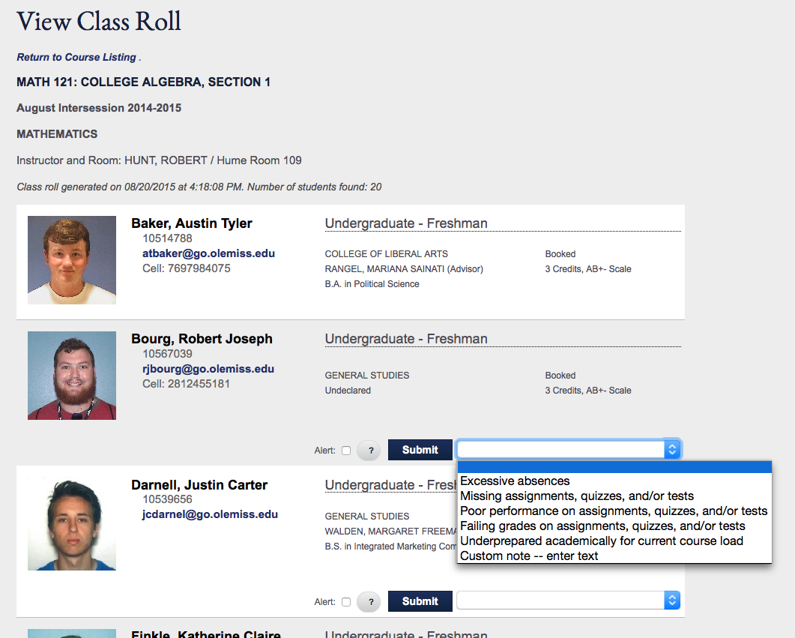




Adding Reasons for Absences
Instructor alerts let you express concerns about academic performance. This notification will be available to advisors. Applicable to pilot group only.

Slide 55
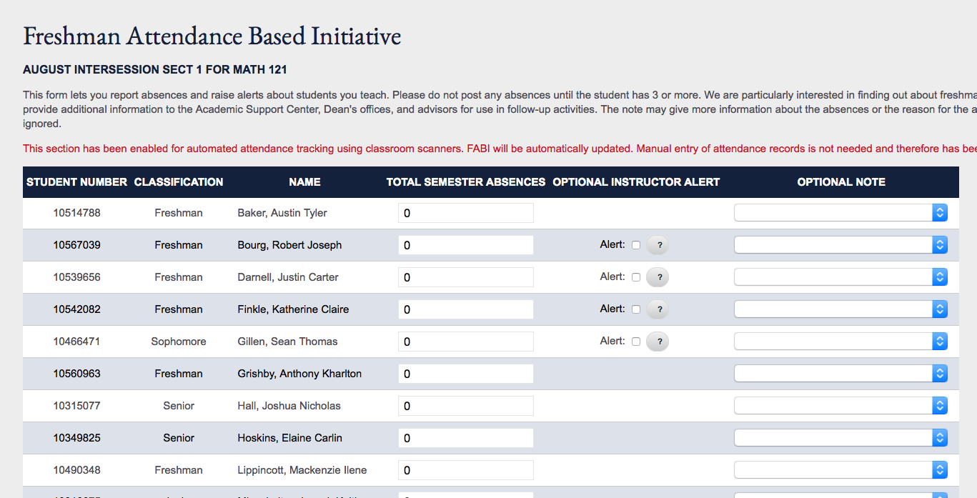
Freshman Attendance Based Initiative
FABI is a program that began in 2001 and has the simple purpose of providing intervention in cases where students have excessive absences. Absences can be reported manually through the online FABI interface or automatically through classroom attendance scanners. With the new Attendance Verification process, FABI will be re-evaluated and possibly discontinued next year.
This is another place where you can enter instructor alerts.

Slide 56
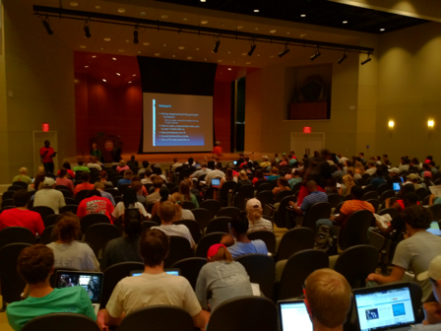
Automated Attendance
The Automated Attendance System was designed to support student retention efforts while lowering the burden placed on faculty members.
Factors
  Record Enrollment
  Hybrid Courses
  Time Constraints
  Attendance Requirements
  attendance.olemiss.edu

Slide 57
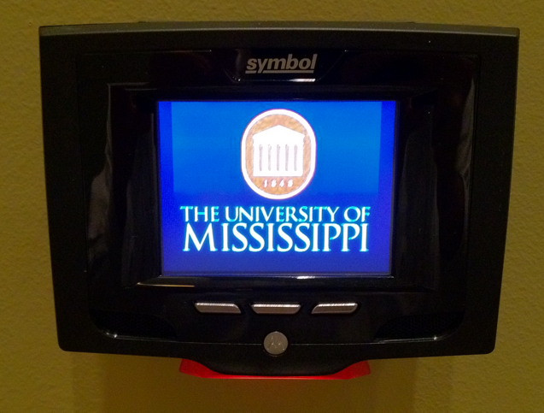
Barcode Scanner

Slide 58
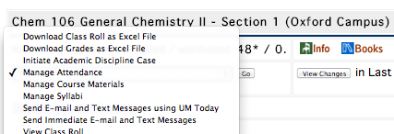
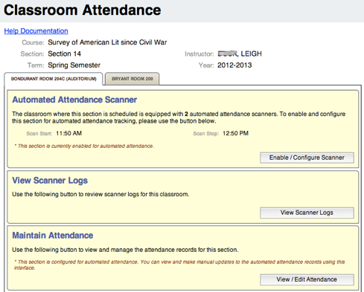
Faculty Interface
Configure Scanner Window
View Scanner Logs
View / Maintain Attendance
Notes:
Update screenshot
Include fine arts

Slide 59
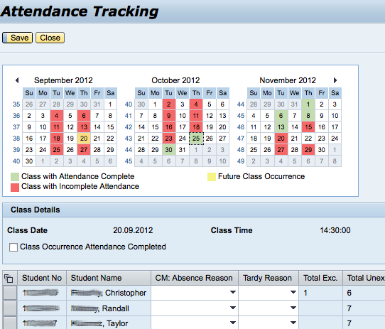
Manually Update Attendance
Select Day
Find Student
Update Attendance Record
  Class Cancelled
  Absent Unexcused
  Absent Excused
  Present

Slide 60
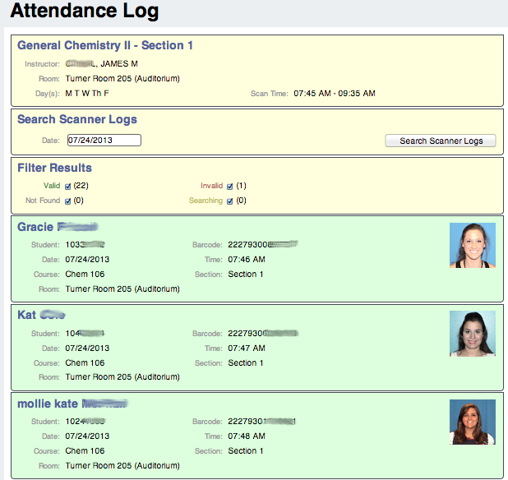
Scanner Log
Class Information
  Professor
  Room
  Day(s)
  Scan Window
Search by Day
Filter Results
  Valid
  Invalid
  Not Found
  Searching (Processing)
Color Coded Scans
  Date / Time
  Student Name / ID / Picture
  Room

Slide 61
Attendance Scanning
181 Scanners
79 Rooms
6,422 Classes
7,768,590 Scans
2,528,779 Absences
47,046 Students
  attendance.olemiss.edu

Slide 62
Scanner Rooms
Anderson Room 11
Anderson Room 137
Anderson Room 21 (Auditorium)
Anderson Room 231
Barnard Observatory Room 105
Bishop Room 101
Bishop Room 102
Bishop Room 103
Bishop Room 104
Bishop Room 105
Bishop Room 106
Bishop Room 107
Bishop Room 108
Bishop Room 112
Bishop Room 209 (Auditorium)
Bishop Room 324
Bondurant Room 204C (Auditorium)
Brevard Room 122
Brevard Room 134 (Auditorium)
Brevard Room 201 (Geology Lab)
Bryant Room 200
Bryant Room 209 (Auditorium)
Carrier Room 211
Carrier Room 220
Coulter Room 200
Coulter Room 204
Coulter Room 211
Farley Room 202 (Auditorium)
Fed Ex Room 207 (Auditorium)
Ford Center Auditorium
Fulton Room 101 (Auditorium)
Holman Room 30 (Auditorium)
Honors College Room 016
Honors College Room 025
Honors College Room 026
Honors College Room 027
Honors College Room 114
Honors College Room 202
Honors College Room 208
Hume Room 101
Hume Room 106
Hume Room 107
Hume Room 108
Hume Room 109
Hume Room 110
Hume Room 111
Hume Room 112
Hume Room 113
Hume Room 201
Hume Room 203
Hume Room 221 Statistic Lab
Jackson Ave. Ctr. Room A001 (Math Lab)
Lamar Room 126
Lamar Room 127
Lamar Room 129
Lamar Room 130
Lamar Room 131
Lamar Room 132
Lamar Room 326
Lamar Room 327
Lamar Room 404 Speaking Center
Lamar Room 515
Lewis Room 101 (Auditorium)
Meek Room 138
Music Building Room 102 (Band Hall)
Music Building Room 123 Nutt Auditorium
Music Building Room 148
Music Building Room 153
Music Building Room 155
Music Building Room 156
Music Building Room 157
Natural Prod Room 1000
Peabody Room 202
Peabody Room 206 (Auditorium)
Shoemaker Room 303
Shoemaker Room 307 (Lab)
Shoemaker Room 313 (Lab)
Tupelo - Advanced Education Center 252
Turner Room 205 (Auditorium)

Slide 63
Impact of Attendance on Grades

Slide 64
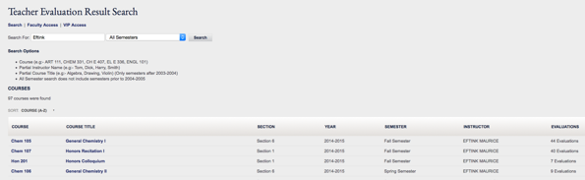
Teacher Evaluations
How it works
  Timeline
  Online submission
  Variable questions
  One narrative question that is available to all on UM’s intranet
  Online reports
Select Teacher Evaluation Results from within myOleMiss

Slide 65
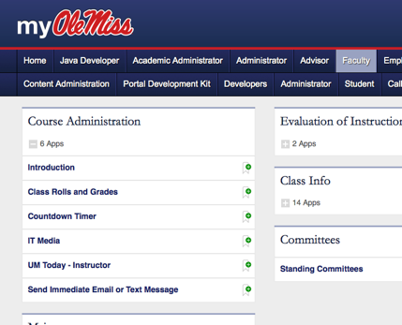
Text Messaging
Emergency Notifications with RebAlert
Student cell phone numbers are in class rolls
Instructors and advisors can send text message to students
  No “from address” so be overly clear.

Slide 66

Related Topics
Advisor Interfaces
  Multiple Advisor Types
    Academic Advisor
    Faculty Mentors
    Other
Academic Discipline
Plagiarism Quiz
Parent WebIDs
  20,000+ accounts
More …

Slide 67
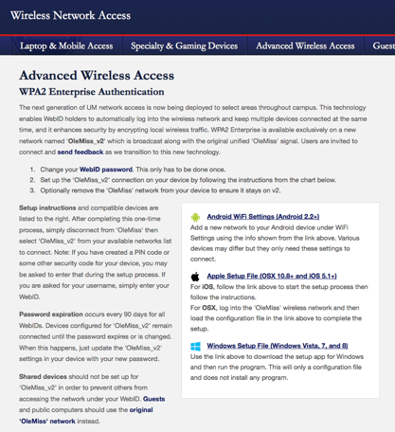
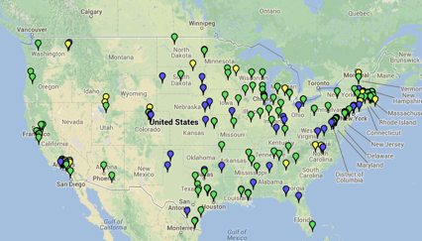
UM Network Features
Advanced Wireless Access
  wireless.olemiss.edu
Eduroam
  eduroam.org
  Lets you use your UM WebID to login to the wireless network of participating institutions

Slide 68
Questions for Chris
Chris Reichley
  reichley@olemiss.edu

Slide 69
For More Information
Brian Hopkins
  bwhopkin@olemiss.edu
Teresa McCarver
  tmc@olemiss.edu
Chris Reichley
  reichley@olemiss.edu
Penny Rice
  parice@olemiss.edu
Amelia Robbins
  amelia@olemiss.edu
Lindsey Sneed
  lrs@olemiss.edu

